Slide 1


Introduction to OAuth Tokens
OAuth tokens are a critical component of modern web and mobile application security, enabling secure and controlled access to sensitive user data and protected resources. These tokens act as digital keys, allowing authorized applications and services to interact with each other on behalf of users, without the need to share usernames, passwords, or other sensitive credentials.

Slide 2

What is an OAuth Token?
1
Definition
An OAuth token is a string of characters that represents an authorization grant given by the resource owner (the user) to the client application (the app or service requesting access).
2
Purpose
OAuth tokens are used to grant limited access to a user's data or protected resources without exposing the user's credentials, such as username and password.
3
Benefits
OAuth tokens provide increased security, flexibility, and control over user data access, making them a crucial component of modern web and mobile application authentication and authorization.

Slide 3
Types of OAuth Tokens
Access Tokens
Refresh Tokens
Authorization Code
These tokens grant direct access to a user's resources, such as their profile information, contacts, or files. They are short-lived and must be periodically refreshed.
Refresh tokens are long-lived credentials used to obtain new access tokens without requiring the user to re-authenticate. They are more sensitive and should be securely stored.
Authorization codes are temporary tokens used in the OAuth 2.0 Authorization Code Grant flow to exchange for access and refresh tokens. They are single-use and have a short lifetime.

Slide 4

Access Tokens
Definition
Access tokens are the primary credentials used by client applications to access a user's protected resources on their behalf. They grant limited, scoped access to specific data or functionality.
Usage
Client applications include the access token in the Authorization header of their API requests to prove their right to access the requested resources.
1
2
3
Lifetime
Access tokens have a limited lifetime, typically ranging from minutes to hours. This ensures that even if a token is compromised, the damage is limited.

Slide 5

Refresh Tokens
Purpose
Refresh tokens are used to obtain new access tokens without requiring the user to re-authenticate. They are long-lived credentials that can be exchanged for a new access token when the current one expires.
Security
Refresh tokens are more sensitive than access tokens, as they can be used to obtain additional access tokens. They must be securely stored and transmitted to prevent unauthorized access.
Lifecycle
Refresh tokens typically have a longer lifetime than access tokens, but they can also be revoked or expired by the authorization server if necessary, for example, if the user's credentials are compromised.
Usage
Client applications use refresh tokens to request new access tokens from the authorization server when the current access token expires, without requiring the user to re-authenticate.

Slide 6
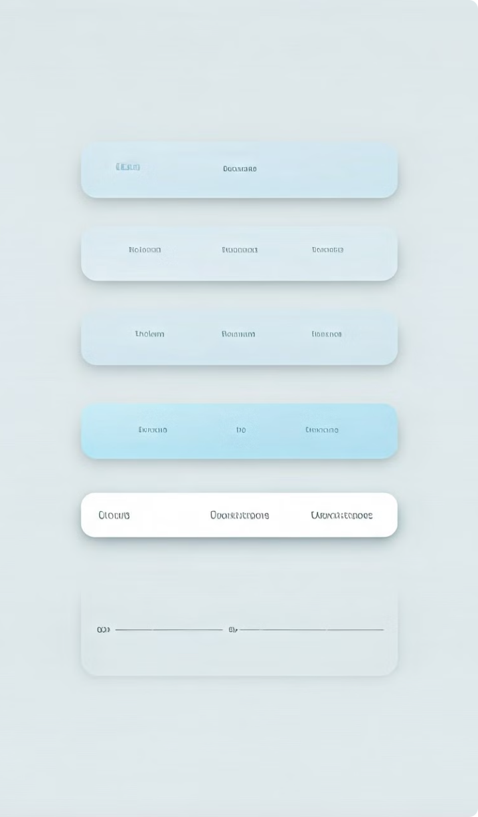




Scopes and Permissions
Email
Grants access to the user's email address and inbox.
Calendar
Allows the application to view and manage the user's calendar events.
Files
Gives the application permission to access the user's stored files and documents.
Profile
Grants access to the user's basic profile information, such as name and profile picture.
OAuth tokens are scoped, meaning they grant access to specific resources or functionality. This allows users to selectively authorize applications to access only the data and features they need, providing greater control and security over their personal information.

Slide 7
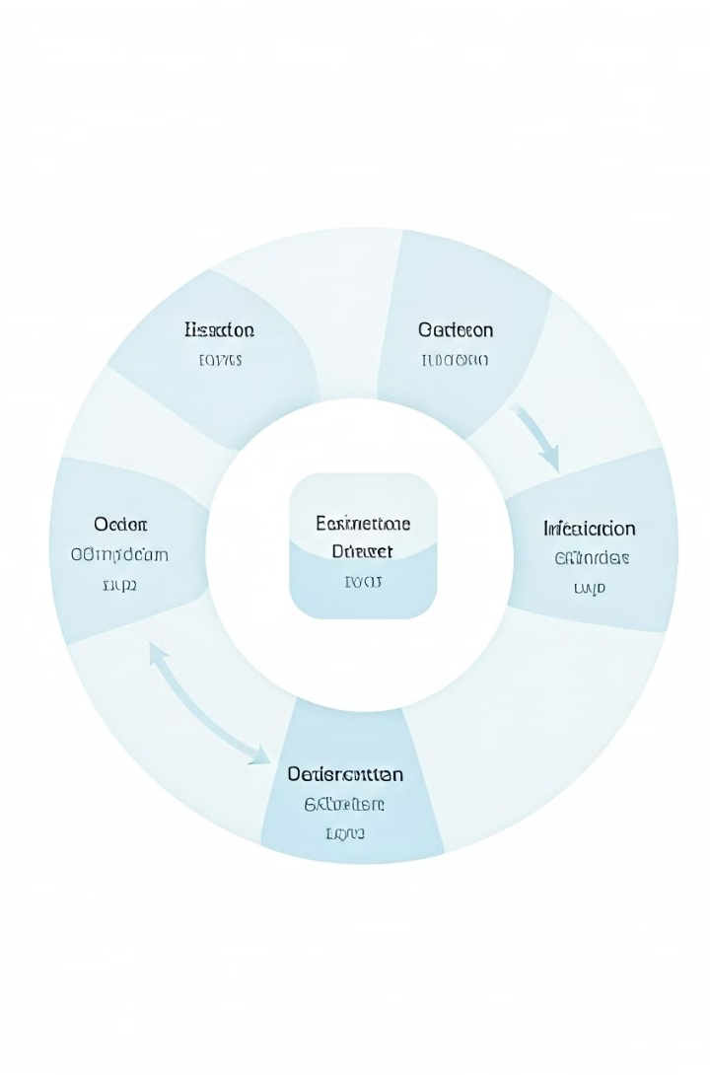




Token Lifecycle Management
Issuance
Tokens are issued by the authorization server when a user grants permission to an application.
Usage
The client application includes the token in requests to access the user's protected resources.
Expiration
Access tokens have a limited lifetime and expire after a certain time, requiring renewal.
Renewal
Refresh tokens are used to obtain new access tokens when the current one expires, without re-authenticating the user.
Effective token lifecycle management is crucial for maintaining the security and integrity of the OAuth system. Organizations must carefully consider token lifetimes, renewal processes, and revocation procedures to prevent unauthorized access and ensure the protection of user data.

Slide 8

Security Considerations
1
Token Storage
2
Transport Security
Tokens must be securely stored, both on the client-side and server-side, to prevent unauthorized access and misuse.
Tokens should always be transmitted over secure, encrypted channels to protect them from interception and tampering.
3
Scope Validation
4
Token Expiration
Applications should carefully validate the scope of each token to ensure they only access the resources they are authorized to use.
Implementing appropriate token lifetimes and renewal processes is crucial to limit the window of potential misuse.
Maintaining the security of OAuth tokens is a critical aspect of the overall system's security. Organizations must adopt best practices for token storage, transmission, scope validation, and lifecycle management to protect user data and prevent unauthorized access.

Slide 9
Best Practices for OAuth Token Usage
Secure Storage
Secure Transmission
Scope Validation
Store tokens securely, using techniques like encryption, key management, and secure containers. Avoid storing them in plain text or client-side storage.
Always transmit tokens over secure, encrypted channels like HTTPS to prevent interception and man-in-the-middle attacks.
Carefully validate the scope of each token to ensure the client application only accesses the resources it is authorized to use.
By following these best practices, organizations can enhance the security of their OAuth-based systems and protect the sensitive user data they are entrusted with. Proper token management is a crucial aspect of maintaining a secure and trustworthy application ecosystem.

Slide 10
Conclusion and Key Takeaways
OAuth tokens are essential for modern web and mobile application security, enabling secure and controlled access to user data and protected resources. By understanding the different types of tokens, their purpose, and the associated security considerations, organizations can implement robust OAuth-based authentication and authorization systems that protect user privacy and maintain trust in their applications.
The key takeaways are:
OAuth tokens provide a secure and flexible way to grant limited access to user data without exposing sensitive credentials.
Proper token lifecycle management, including secure storage, transmission, and renewal, is crucial for maintaining the overall security of the system.
Following best practices, such as scope validation and secure storage, can help organizations prevent unauthorized access and protect user privacy.

